Slide 1
Supply Chain Management

Slide 2
Supply Chain Management - Introduction
Material B
Factory
1
Material A
Factory
2
The
Customer
(Retailer)
Factory
3
Material C
Factory
4
Factory
5

Slide 3
Overview of Supply Chain
The supply chain-a network of organizations and the business processes for acquiring the raw materials, transforming them into finished goods, and distributing the products to the customers. The supply chain links many business entities, such as supplier, manufacturer, transporter, distributor, retailer, and the customers themselves.
The supply chain is driven by three main inputs namely information, materials and funds which flow among the supply chain members.
The raw material sources from suppliers are transformed to intermediate products and finished goods through manufacturing facilities. The finished products are shipped to distribution centers and from there to retailers and ultimately to customers. However, the supply chains, especially of large manufacturers, can have primary, secondary, and tertiary suppliers also.
The ultimate goal of supply chain management systems is to efficiently manage the flow of information, materials, and funds across the entire supply chain, thereby reducing the cost of supply chain while bringing a firm’s products from concept to market.
Note that the supply chains of different organizations may differ in the number of entities and it is not always required for a supply chain to have all the entities. Each entity in the supply chain contributes to the goal of reaching the customers.

Slide 4
Introduction to Supply chain management
What is supply chain?
Supply chain refers the entire network of companies that work together to design, produce, deliver and service products.
or A supply chain is a sequence of organizations - their facilities, functions and activities - that are involved in producing and delivering a product or service.
A value chain is another name for a supply chain.
Supply chain management (SCM) is a business and technology discipline that refers to the ways of coordinating the activities involved in purchasing, designing, building and selling a product.
SCM includes managing supply and demand, sourcing raw materials and parts, manufacturing and assembly, warehousing and inventory tracking, order entry and order management, distribution across all the channels, delivery to the customers.

Slide 5
Contd.
More definitions:
Supply chain management deals with the management of materials, information, and financial flows in a network consisting of suppliers, manufacturer, distributor and customers.
SCM involves “managing the flow of items, information, cash and ideas through the coordination of supply chain processes and through the strategic addition of place, period ad pattern values.”
Supply chain management is a set of approaches utilized to efficiently integrate suppliers, manufacturers, warehouses, and stores, so that merchandise is produced and distributed at the right quantities, to the right locations, and at the right time, in order to minimize system wide costs while satisfying service level requirements.

Slide 6
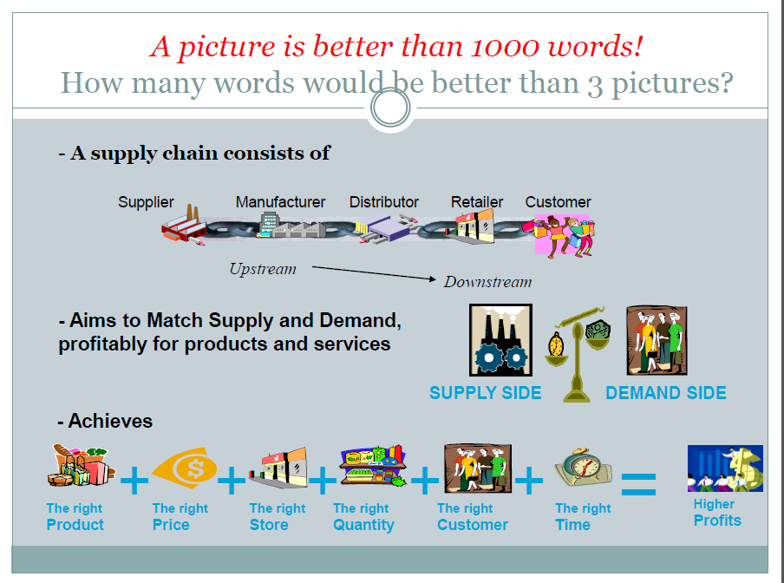

Slide 7
Objective of SCM
The various objectives of Supply Chain Management which are applicable for International Logistics and Supply Chain management.
1.To maximize overall value generated
2.To look for Sources of Revenue and Cost
3. Replenishment of the Material or Product whenever required
4. Quality Improvement
5. Shortening time to Order
6. To speedup the Market and maximize efficiency of distribution side
7. To meet consumer demand for guaranteed delivery of high quality and low cost with minimal lead time.
8. Helps in better decision
9. To achieve world class performance
10. More awareness of supply chain dynamics and efficiency
11. To fulfill customer demand through efficient resources
12. To optimize pre and post production inventory levels
13. Good understanding of business characteristics
14. Provide flexible planning and control mechanism
15. Reduce transportation cost

Slide 8
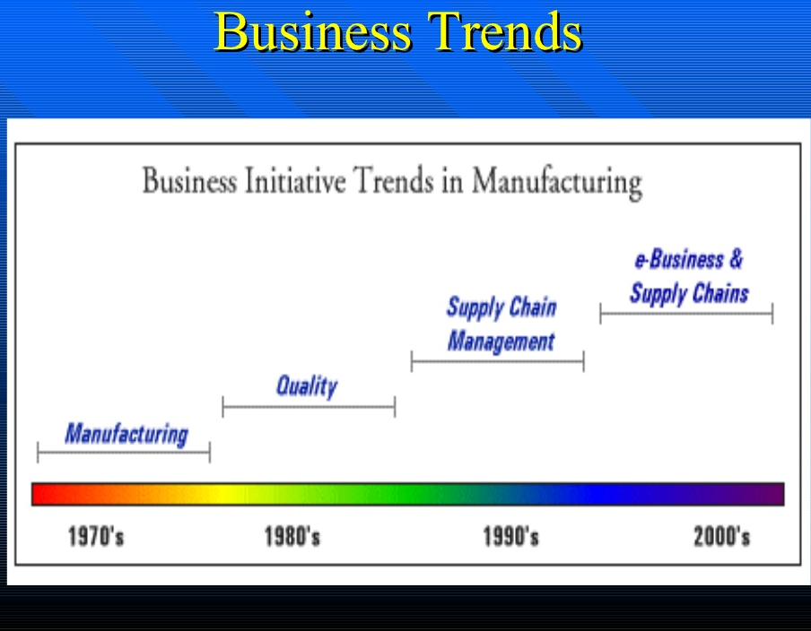

Slide 9
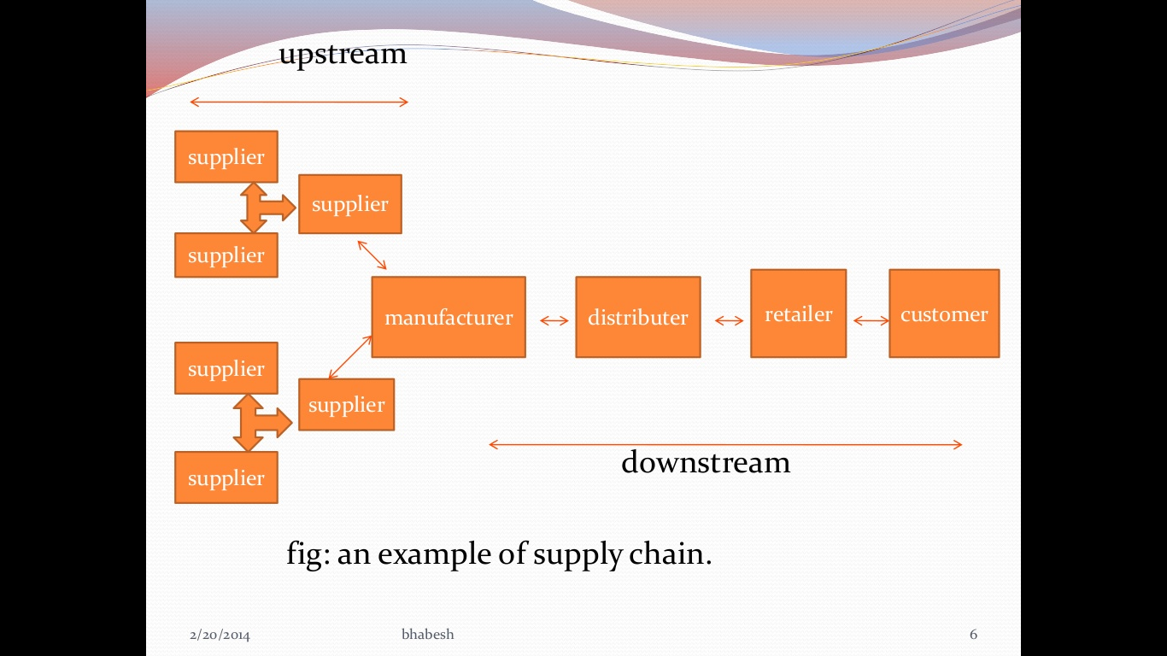

Slide 10
Types of Supply Chain
If the company is a traditional one, it will produce items that will be stored in warehouses and other locations, making the supply chain more complex. If the company uses a make-to-order business model, there will be no need for storing finished products, but there will be need to store raw materials and components. Therefore, it is clear that supply chains depend on the nature of the company. The following four types are very common.
1. Integrated Make-to-Stock Model: The integrated make-to-stock supply chain model focuses on tracking customer demand in real time, so that the production process can restock the finished goods inventory efficiently. Through application of such a system, the organization can receive real-time demand information that can be used to develop and modify production plans and schedules.
An example is Starbucks Coffee (starbucks.com) which uses several distribution channels, not only selling coffee drinks to consumers, but also selling beans and ground coffee to businesses such as airlines, supermarkets, department stores, and ice-cream makers. Sales are also done through direct mail, including the Internet. Starbucks is successfully integrating all sources of demand and matching it with the supply by using Oracle’s automated information system for manufacturing (called GEMMS). The system does distribution planning, manufacturing scheduling, and inventory control (using MRP). The coordination of supply with multiple distribution channels requires timely and accurate information flow about demand, inventories, storage capacity, transportation scheduling, and more. The information systems are critical in doing all the above with maximum effectiveness and reasonable cost. Finally, Starbucks must work closely with hundreds of business partners.

Slide 11
Contd.
2. Build-to-Order Model:
In this model a company begins assembly of the customer’s order almost immediately upon receipt of the order. This requires careful management of the component inventories and delivery of needed supplies along the supply chain. A solution to this potential inventory problem is to utilize many common components across several production lines and in several locations.
One of the primary benefits of this type of supply chain model is the perception that each customer is receiving a personalized product. In addition, the customer is receiving it rapidly. This type of supply chain model supports the concept of mass customization.
Example: Dell Computer is best known for its application of the build-to-order model.

Slide 12
Contd.
3. Continuous Replenishment Model:
The idea of the continuous replenishment supply chain model is to constantly replenish the inventory by working closely with suppliers and/or intermediaries. Real-time information about demand changes is required in order for the production process to maintain the desired replenishment schedules and levels.
This model is most applicable to environments with stable demand patterns, as is usually the case with distribution of prescription medicine.

Slide 13
Contd.
4. Channel Assembly Model:
In this model, the parts of the product are gathered and assembled as the product moves through the distribution channel. This is accomplished through strategic alliances with third-party logistics (3PL) firms. These services sometimes involve either physical assembly of a product at a 3PL facility or collection of finished components for delivery to the customer.
For example, a computer company would have items such as the monitor shipped directly from its vendor to a 3PL facility (e.g., one run by Federal Express or UPS). The customer’s computer order would therefore only come together once all items were placed on a vehicle for delivery. A channel assembly may have low or zero inventories, and it is popular in the computer technology industry.

Slide 14
Key Business Processes
Customer relationship management:
Allows companies to prioritize their marketing focus on different customer groups according to each group’s long-term value to the company or supply chain.
Customer service management:
Presents a multi-company, unified response system to the customer whenever complaints, concerns, questions, or comments are voiced
Demand management:
Seeks to align supply and demand throughout the supply chain by anticipating customer requirements at each level and create demand-related plans of action prior to actual customer purchasing behavior
Order or distribution fulfillment:
a highly integrated process, often requiring persons from multiple companies and multiple functions to come together and coordinate to create customer satisfaction at a given place and time

Slide 15
Contd.
Manufacturing flow management:
Concerned with ensuring that firms in the supply chain have the needed resources to manufacture with flexibility and to move products through a multi-stage production process
Supplier relationship management:
Closely related to the manufacturing flow management process and contains several characteristics that parallel the customer relationship management process
Product development and commercialization:
Includes the group activities that facilitates the joint development and marketing of new offerings among a group of supply chain partner firms
Returns management:
Enables firms to manage volumes of returned product efficiently, while minimizing returns-related costs and maximizing the value of the returned assets to the firms in the supply chain

Slide 16
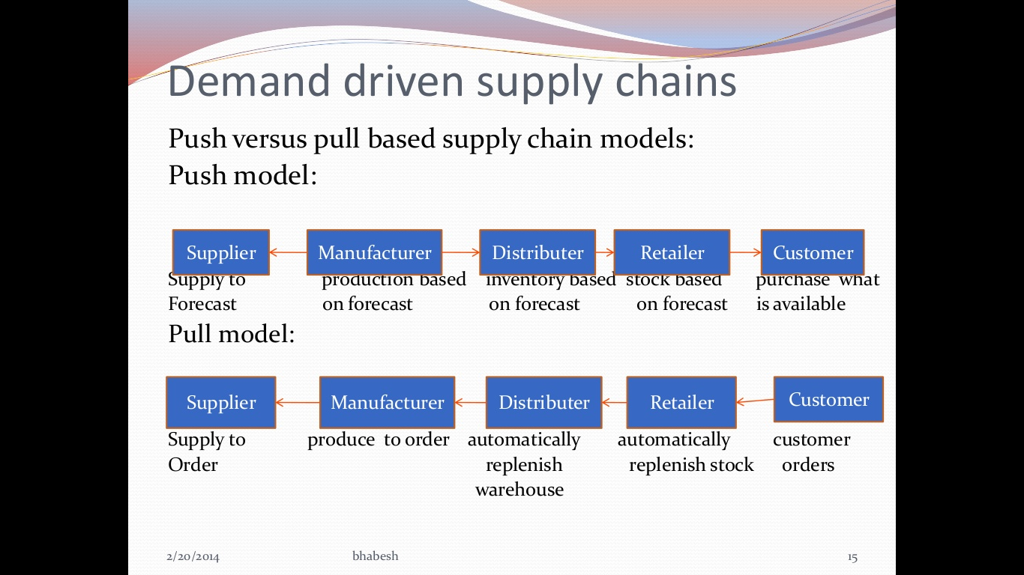

Slide 17
Variability in SCM
Demand Variability:
Even the most sophisticated demand forecasting tools often fails to anticipate the demand.
Process Variability:
Unexpected staff absence
wrong inventory forecast
Supply Variability:
Late delivery from supplier

Slide 18
Levels of Decisions in the Supply Chain
In order to make sure that the above supply chain is running smoothly and also to ensure maximum customer satisfaction at the lowest possible cost, organizations adopt supply chain management processes and various technologies to assist in these processes.
There are three levels of activities/decision in Supply Chain Management with that different departments of an organization focus on to achieve the smooth running of the supply chain. They are:
Strategic Decision
Tactical Decision
Operational Decision

Slide 19
Contd.
Strategic - At this level, senior management is involved in the supply chain process and makes decisions that concern the entire organization and “what processes each stage will perform?”. Every effective supply chain strategy begins with solid long-term decision-making. The strategic level lays the groundwork for the entire supply chain process, from beginning to end, and is an essential part of supply chain management. Decisions made at this level include the size and site of the production area, the collaborations with suppliers, and the type of that product that is going to be manufactured and so forth.
Decisions addressed at this level include:
Designing the SCM to meet the organizational goal
Recognize and clear state vision
Recognize business trend, priorities
Choosing the site and purpose of business facilities
Creating a network of reliable suppliers, transporters, and logistics handlers
Long-term improvements and innovations to meet client demands
Inventory and product management throughout its life cycle
IT programs and systems to make the process more effective
Involved top level management

Slide 20
Contd.
Tactical - “ How to achieve the strategic goals?” ,Tactical level of activity focuses on achieving lowest costs for running the supply chain. Businesses make mid-term decisions involving the supply chain at the tactical level. At the strategy level, general planning begins, but processes are actually defined at the tactical level. Tactical decisions play a big role in controlling costs and minimizing risks. At this level, the focus is on customer demands and achieving the best end value. Some of the ways this is done is by creating a purchasing plan with a preferred suppliers and working with transportation companies for cost effective transport.
Common concerns include:
Procurement contracts for necessary materials and services
Mid term planning and mid level management involved
Production schedules and guidelines to meet quality, safety, and quantity standards
Transportation and warehousing solutions, including outsourcing and third-party options
Inventory logistics and policies, including storage and end-product distribution
Adopting best practices in comparison to competitors

Slide 21
Contd.
Operational - At the operational level, activity decisions are made on a day-to-day basis and these decisions affect how the product distribute along the supply chain. Some of the decisions taken at this level include taking customer orders and the movement of goods from the warehouse to the point of consumption. To keep the supply chain active, this level played an important role but plans and decisions for real execution is made at the above levels. The mistake that many companies make is to jump straight into operational management without focusing on the strategy and tactical levels. Effective operational level processes are the result of strong strategic and tactical planning.
Some aspects of operational level management are:
Daily and weekly forecasting to figure out and satisfy demand(Short term planning)
Production operations, including scheduling and detailed management of goods-in-process
Monitoring logistics activity for contract and order fulfillment
Settling damages or losses with suppliers, vendors, and clients
Managing incoming and outgoing materials and products, as well as on-hand inventories
Goal implemented in such a way to be effectively implemented at operational level

Slide 22
Benefits of Supply Chain Management
Lower inventory, transportation, warehousing, and packaging costs
Greater supply chain flexibility and eliminated rush(unplanned) activity
Improved customer services
Minimizes delays
Reduces the uncertainty of chain
Higher revenues
Increased performance and profitability

